Slide 1
Weather and Emotions in Kichwa
Tod Dillon Swanson

Slide 2
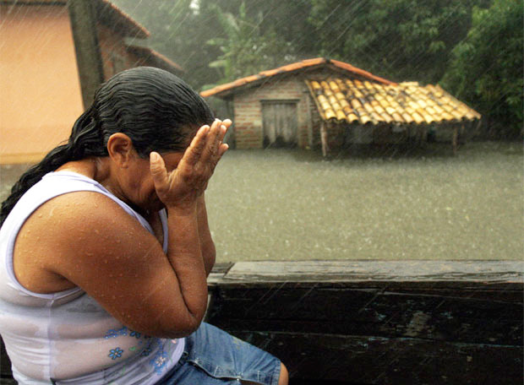
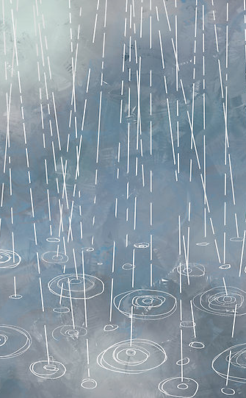
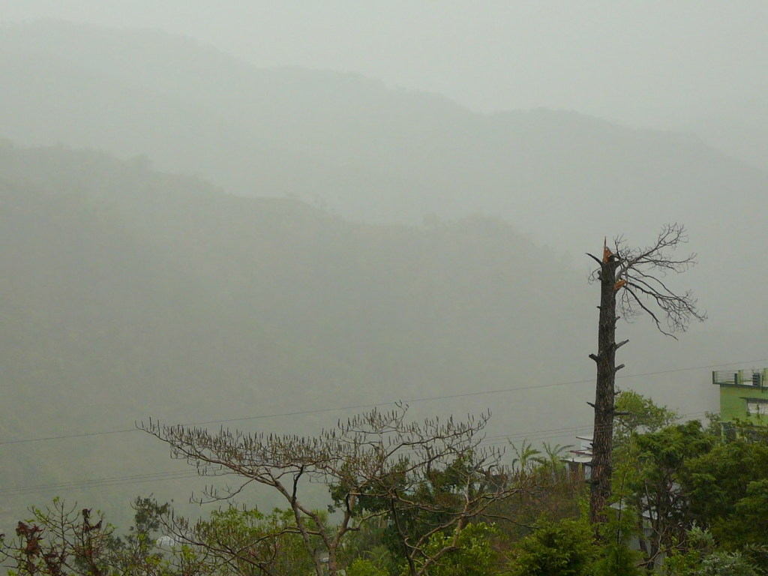
Maicambi tamiara rikusha asisha yanga tapunun.
“Ima rashara llakiringui?”
tukuna = to become.

Slide 3
Sometimes when the see the rain they laugh and ask teasingly,
“Why are you sad?”
tukuna = to become.

Slide 4
“Ima rashami wakangui?”
tukuna = to become.

Slide 5
“Why are you crying?”
tukuna = to become.

Slide 6
Karichu kanda sakisha rika?
tukuna = to become.

Slide 7
Did your husband go leaving you?
tukuna = to become.

Slide 8
Ari. Ñukara ichusa rijpimi wakani.
tukuna = to become.

Slide 9
Yes. I am crying because he went dumping me.
tukuna = to become.

Slide 10
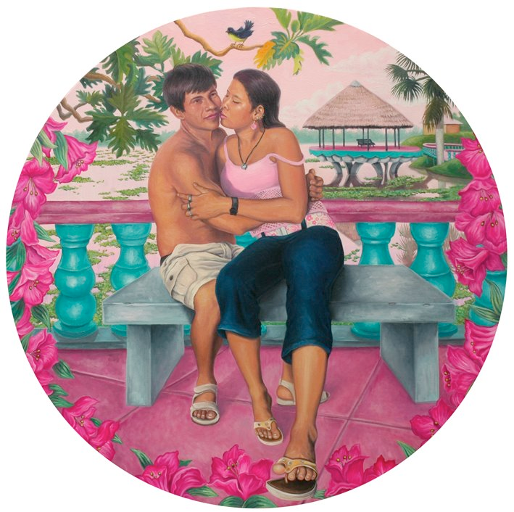
Waari irustami ukllariunguichi! Ama ukllarichichu

Slide 11
Whoooah! You are hugging embarrassingly. Don’t hug

Slide 12
Gustu indi puhzha ajta wagllichinguichimi!
Gustu indi puhzha ajta wagllichinguichimi!

Slide 13
You are going to ruin a nice sunny day!

Slide 14
Yangamanda tamiara kayanguichimi!

Slide 15
You are calling the rain for no good reason!

Slide 16
Yaku patama ringuichi!

Slide 17
Go to the beach!

Slide 18
Ujllarinara sakichi! Sasimi!

Slide 19
Stop hugging! It is prohibited!

Slide 20
Oriente pambai tang takaillami!

Slide 21
The Oriente is delicate.

Slide 22
Chi raigu estudianteuna tiaushkai yapa tamian.

Slide 23
That is why it rains a lot when the students are here.

Slide 24
Tutas punzhas tamian.

Slide 25
It rains day and night.

Slide 26
Chita riparani

Slide 27
I have noticed that.

Slide 28
Warminaichisha karinaichisha purinun.

Slide 29
They walk wanting to become husband and wife.

