Slide 1
Arranging the Length of a Stay
This exercise tests oral and written comprehension on arranging the length of a stay at an intermediate/advanced level. In particular it features practice using the word “tukungak” in this context. Each slide set begins with an audio recording by a native speaker speaking in colloquial Kichwa at normal speed. On this slide there is no text but the audio is accompanied by a picture.
Listen to the sentence repeatedly until you can write down what you hear on the blank quote bubble above the speaker.
When you move to the next slide you will find the answer in the form of the transcribed sentence. Translate this sentence into English.
Move to the next slide which contains the translation. Compare your translation to the translation provided. Memorize any unknown vocabulary or grammatical construction.
Where applicable practice the grammatical construction using substitution.

Slide 2
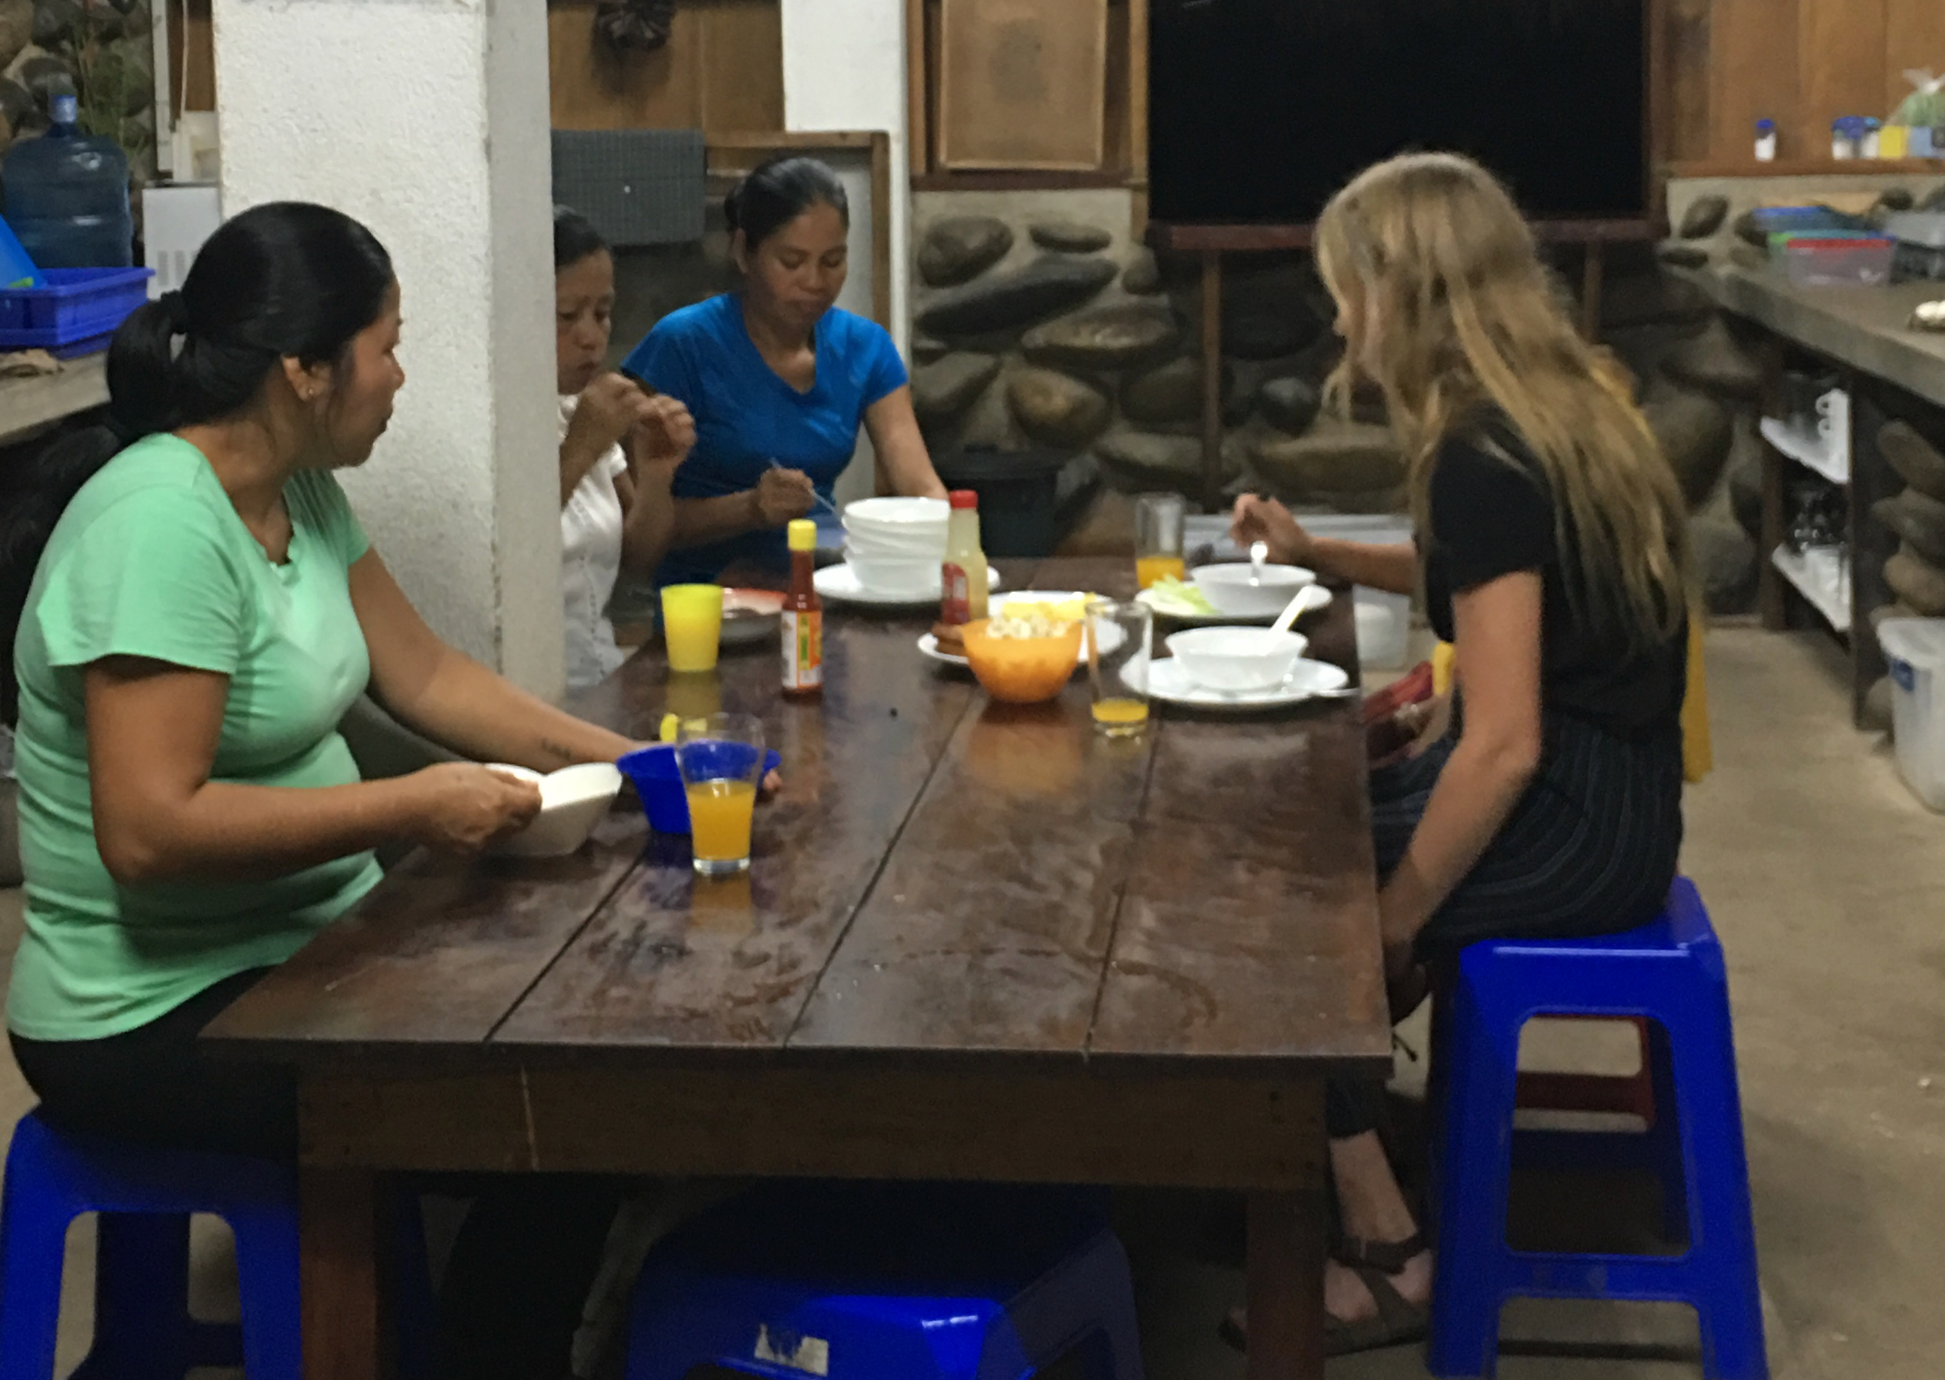

Slide 3
Imasna tukungakta shamungui.

Slide 4
How long will you be here?

Slide 5
Imasna semanajta shamukangui?

Slide 6
Imasna punzhakta shamukangui?
Imasna semanajta shamukangui?

Slide 7
For how many days have you come to stay?

Slide 9
Mana punzhajlla shamuni.

Slide 10
I have not come for just a few days.

Slide 11
Substitute other units of time:
wata
simana
killa
wata.
Mana semanajlla shamuni.
Now do the same with activities:
pugllana
mikuna
rimana
yachachina
kullkira apina
I have not come for just a year

Slide 13
I have come to spend two weeks here.

Slide 14
Ñuka kaivi ishki semana tukungak shamuni.

Slide 16
Ishki killa tupu shamuni.

Slide 17
I have come for about two months

Slide 19
Usharikpi shuj killa tukusha.

Slide 20
If I can I will stay for a month.

Slide 21
Substitution. I have come for a period of ____________
5 days Pichka punzha tupu shamuni.
3 years
4 months

Slide 23
Chi washa shuj kumunidadma ringarauni.

Slide 24
After that I will go to another community.

Slide 26
Ima urasta tigraungui?

Slide 27
What time will you return?

Slide 29
Tutayamushkai tigrasha.

Slide 30
I will return at dusk.

Slide 31
See you next year.

Slide 32
Shuj watagama.

